Slide 1
Graphs
Chapter 10 from Data Structures by Koffman & Wolfgang

Slide 2
Chapter Objectives
To become familiar with graph terminology and the different types of graphs
To study a Graph data structure and different implementations of the Graph data structure
To learn the breadth-first and depth-first search traversal algorithms
To learn some algorithms involving weighted graphs
To study some applications of graphs and graph algorithms

Slide 3
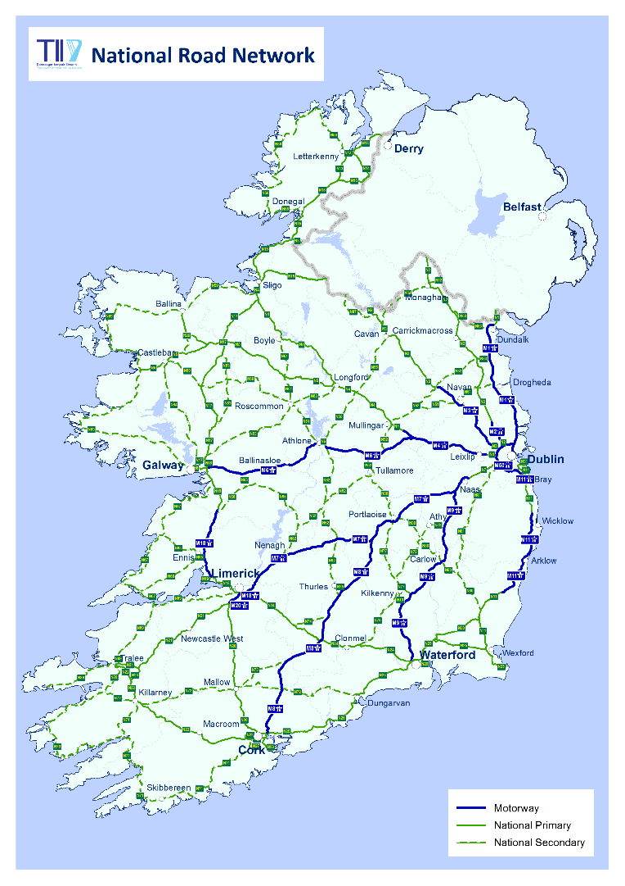
Our National Road Network
http://www.tii.ie/roads-tolling/our-road-network/

Slide 4
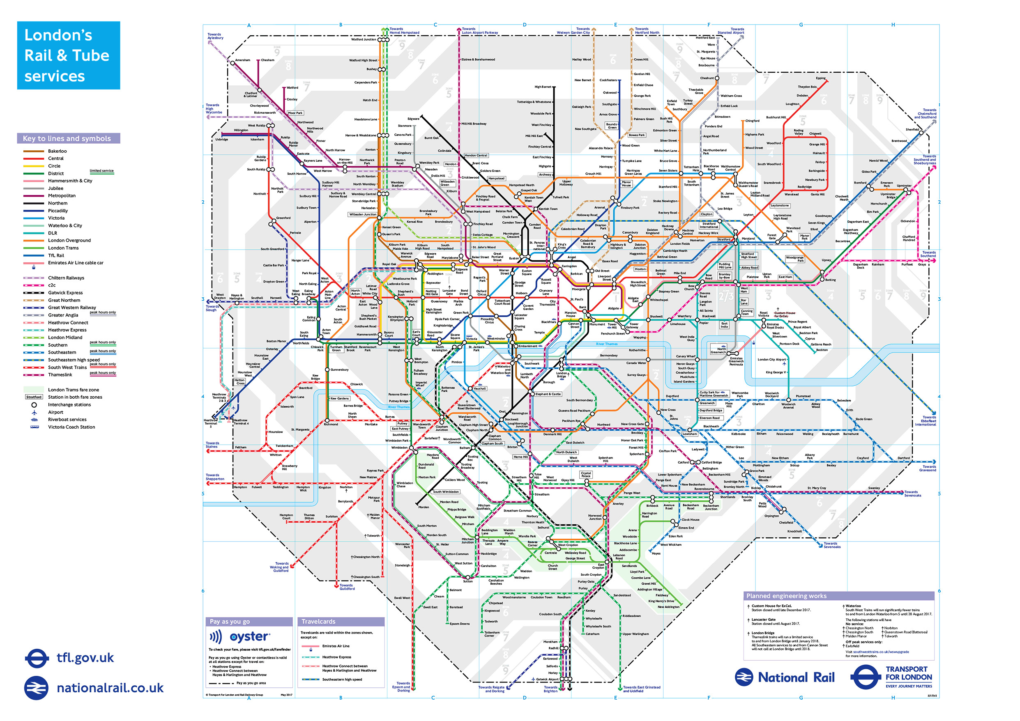
London Underground
https://tfl.gov.uk/maps/track?intcmp=40400

Slide 5
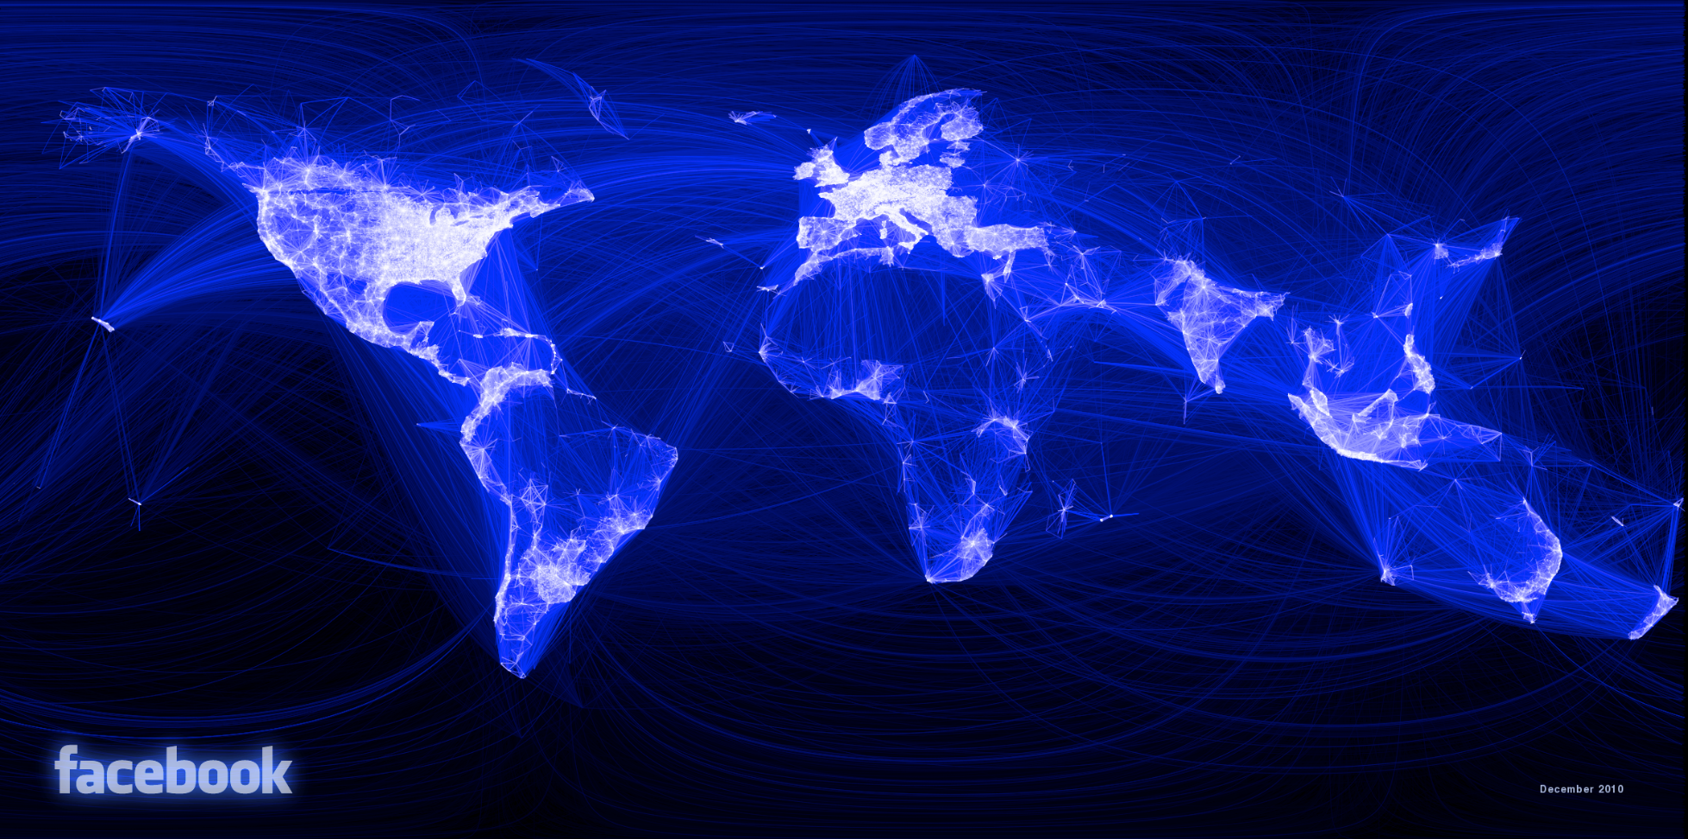
500 Million Facebook friends
https://www.facebook.com/notes/facebook-engineering/visualizing-friendships/469716398919/

Slide 6
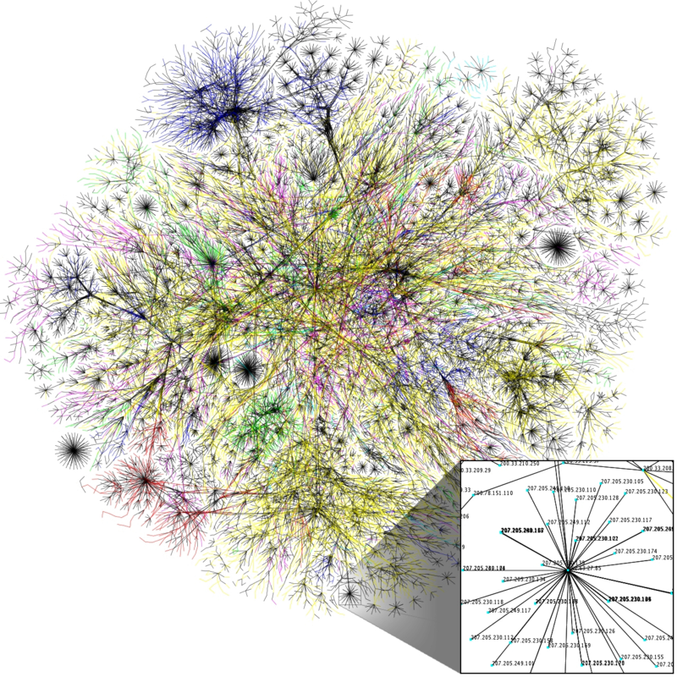
An Opte Project visualization of routing paths through the Internet
https://en.wikipedia.org/wiki/Internet
Notes:
Partial map of the Internet based on the January 15, 2005 data found on opte.org. Each line is drawn between two nodes, representing two IP addresses. The length of the lines are indicative of the delay between those two nodes.

Slide 7
Graphs
Trees are limited in that a data structure can only have one parent
Graphs overcome this limitation
Graphs were being studied long before computers were invented
Graphs algorithms run
large communication networks
the software that makes the Internet function
programs to determine optimal placement of components on a silicon chip
Graphs describe
roads maps
airline routes
course prerequisites

Slide 8
Graph Terminology
Section 10.1

Slide 9
Graph Terminology
A graph is a data structure that consists of a set of vertices (or nodes) and a set of edges (relations) between pairs of vertices
Edges represent paths or connections between vertices
Both the set of vertices and the set of edges must be finite
Either set may be empty (if the set of vertices is empty, the set of edges also must be empty)
We restrict our discussion to simple graphs in which there is at least one edge from a given vertex to another vertex
Notes:
We use the term vertex generally instead of node (which we used for trees) – they are the same

Slide 10
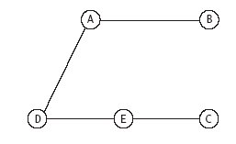
Visual Representation of Graphs
Vertices are represented as points or labeled circles and edges are represented as line segments joining the vertices
V = {A, B, C, D, E}
E = {{A, B}, {A, D}, {C, E}, {D, E}}

Slide 11
Visual Representation of Graphs (cont.)
Each edge is represented by the two vertices it connects
If there is an edge between vertices x and y, there is a path from x to y and vice versa

Slide 12
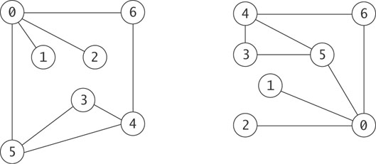
Visual Representation of Graphs (cont.)
The physical layout of the vertices and their labeling is not relevant
V = {0, 1, 2, 3, 4, 5, 6}
E = {{0, 1}, {0, 2}, {0, 5}, {0, 6}, {3, 5}, {3, 4}, {4, 5}, {4, 6}}

Slide 13
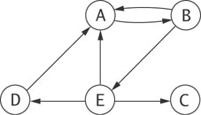
Directed and Undirected Graphs
The edges of a graph are directed if the existence of an edge from A to B does not necessarily guarantee that there is a path in both directions
A graph with directed edges is called a directed graph or digraph
A graph with undirected edges is an undirected graph, or simply a graph

Slide 14
Directed and Undirected Graphs (cont.)
A directed edge is like a one- way street; you can travel in only one direction
Directed edges are represented as lines with an arrowhead on one end (undirected edges do not have an arrowhead at either end)
Directed edges are represented by ordered pairs of vertices {source, destination}; the edges for the digraph on this slide are:
{{A, B}, {B, A}, {B, E}, {D, A}, {E, A}, {E, C}, {E, D}}

Slide 15
Directed and Undirected Graphs (cont.)
The edges in a graph may have associated values known as their weights
A graph with weighted edges is known as a weighted graph
Ann Arbor
50
Detroit
40
60
120
Cleveland
130
Pittsburgh
260
Toledo
320
Chicago
148
155
150
Fort Wayne
180
Philadelphia
180
120
180
Indianapolis
Columbus

Slide 16
Paths and Cycles
The following definitions describe pathways between vertices

Slide 17
Paths and Cycles (cont.)
Ann Arbor
50
Detroit
40
60
Cleveland
Pittsburgh
120
130
260
Toledo
320
Chicago
148
155
150
Fort Wayne
180
Philadelphia
180
120
180
A vertex is adjacent to another vertex if there is an edge to it from that other vertex
Indianapolis
Columbus

Slide 18
Paths and Cycles (cont.)
Philadelphia is adjacent to Pittsburgh
Ann Arbor
50
Detroit
40
60
Cleveland
Pittsburgh
120
130
260
Toledo
320
Chicago
148
155
150
Fort Wayne
180
Philadelphia
180
120
180
A vertex is adjacent to another vertex if there is an edge to it from that other vertex
Indianapolis
Columbus

Slide 19
Paths and Cycles (cont.)
Ann Arbor
50
Detroit
40
60
Cleveland
Pittsburgh
120
130
260
Toledo
320
Chicago
148
155
150
Fort Wayne
180
Philadelphia
180
120
180
A vertex is adjacent to another vertex if there is an edge to it from that other vertex
Indianapolis
Columbus
Indianapolis is adjacent to Columbus

Slide 20
Paths and Cycles (cont.)
A is adjacent to D, but D is NOT adjacent to A
A
B
D
E
C
A vertex is adjacent to another vertex if there is an edge to it from that other vertex

Slide 21
Paths and Cycles (cont.)
Ann Arbor
50
Detroit
40
60
Cleveland
Pittsburgh
120
130
260
Toledo
320
Chicago
148
155
150
Fort Wayne
180
Philadelphia
180
120
180
A path is a sequence of vertices in which each successive vertex is adjacent to its predecessor
Indianapolis
Columbus

Slide 22
Paths and Cycles (cont.)
Ann Arbor
50
Detroit
40
60
Cleveland
Pittsburgh
120
130
260
Toledo
320
Chicago
148
155
150
Fort Wayne
180
Philadelphia
180
120
180
A path is a sequence of vertices in which each successive vertex is adjacent to its predecessor
Indianapolis
Columbus

Slide 23
Paths and Cycles (cont.)
Ann Arbor
50
Detroit
40
60
Cleveland
Pittsburgh
120
130
260
Toledo
320
Chicago
148
155
150
Fort Wayne
180
Philadelphia
180
120
180
In a simple path, the vertices and edges are distinct except that the first and last vertex may be the same
Indianapolis
Columbus

Slide 24
Paths and Cycles (cont.)
Ann Arbor
50
Detroit
40
60
Cleveland
Pittsburgh
120
130
260
Toledo
320
Chicago
148
155
150
Fort Wayne
180
Philadelphia
180
120
180
In a simple path, the vertices and edges are distinct except that the first and last vertex may be the same
Indianapolis
Columbus
This path is a simple path

Slide 25
Paths and Cycles (cont.)
Ann Arbor
50
Detroit
40
60
Cleveland
Pittsburgh
120
130
260
Toledo
320
Chicago
148
155
150
Fort Wayne
180
Philadelphia
180
120
180
In a simple path, the vertices and edges are distinct except that the first and last vertex may be the same
Indianapolis
Columbus
This path is NOT a simple path

Slide 26
Paths and Cycles (cont.)
Ann Arbor
50
Detroit
40
60
Cleveland
Pittsburgh
120
130
260
Toledo
320
Chicago
148
155
150
Fort Wayne
180
Philadelphia
180
120
180
A cycle is a simple path in which only the first and final vertices are the same
Indianapolis
Columbus

Slide 27
Paths and Cycles (cont.)
Ann Arbor
50
Detroit
40
60
Cleveland
Pittsburgh
120
130
260
Toledo
320
Chicago
148
155
150
Fort Wayne
180
Philadelphia
180
120
180
A cycle is a simple path in which only the first and final vertices are the same
Indianapolis
Columbus
In an undirected graph a cycle must contain at least three distinct vertices
Pittsburgh → Columbus → Pittsburgh
is not a cycle

Slide 28
Paths and Cycles (cont.)
Ann Arbor
50
Detroit
40
60
Cleveland
Pittsburgh
120
130
260
Toledo
320
Chicago
148
155
150
Fort Wayne
180
Philadelphia
180
120
180
An undirected graph is called a connected graph if there is a path from every vertex to every other vertex
Indianapolis
Columbus

Slide 29
Paths and Cycles (cont.)
Ann Arbor
50
Detroit
40
60
Cleveland
Pittsburgh
120
130
260
Toledo
320
Chicago
148
155
150
Fort Wayne
180
Philadelphia
180
120
180
An undirected graph is called a connected graph if there is a path from every vertex to every other vertex
Indianapolis
Columbus
This graph is a connected graph

Slide 30
Paths and Cycles (cont.)
4
5
6
7
8
9
An undirected graph is called a connected graph if there is a path from every vertex to every other vertex

Slide 31
Paths and Cycles (cont.)
4
5
6
7
8
9
An undirected graph is called a connected graph if there is a path from every vertex to every other vertex
This graph is a connected graph

Slide 32
Paths and Cycles (cont.)
4
5
6
7
8
9
An undirected graph is called a connected graph if there is a path from every vertex to every other vertex

Slide 33
Paths and Cycles (cont.)
4
5
6
7
8
9
An undirected graph is called a connected graph if there is a path from every vertex to every other vertex
This graph is NOT a connected graph

Slide 34
Paths and Cycles (cont.)
4
5
6
7
8
9
If a graph is not connected, it is considered unconnected, but still consists of connected components

Slide 35
Paths and Cycles (cont.)
{4, 5} are connected components
4
5
6
7
8
9
If a graph is not connected, it is considered unconnected, but will still consist of connected components

Slide 36
Paths and Cycles (cont.)
4
5
6
7
8
9
{6, 7, 8, 9} are connected components
If a graph is not connected, it is considered unconnected, but will still consist of connected components

Slide 37
Paths and Cycles (cont.)
A single vertex with no edge is also considered a connected component
4
6
7
8
9
If a graph is not connected, it is considered unconnected, but will still consist of connected components

Slide 38
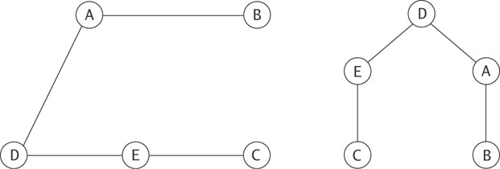
Relationship between Graphs and Trees
A tree is a special case of a graph
Any graph that is
connected
contains no cycles (acyclic)
can be viewed as a tree by making one of the vertices the root

Slide 39
Graph Applications
Graphs can be used to:
determine if one vertex in a network is connected to all the others
map out multiple course prerequisites (a solution exists if the graph is a directed graph with no cycles)
find the shortest route from one city to another (least cost or shortest path in a weighted graph)
Notes:
Graphs occur frequently both in real life and in computing:
A road network is a graph whose vertices are cities and whose edges are roads connecting these cities. The edge attributes are typically distances.
A pipeline network is a directed graph whose vertices are pumping stations and whose edges are pipelines connecting them.
An activity chart is a directed graph whose vertices are activities and whose edges signify the order in which these activities must be performed.
A curriculum at a third-level college is a collection of modules where each module identifies other modules as its prerequisites
Search engines like Google model the Internet as a graph:
Web pages are the vertices
Links among Web pages are the edges
This is a directed graph – a link from one page to another does not necessarily imply a link in the reverse order

Slide 40
The Graph data structure and Edge Class
Section 10.2

Slide 41
Implementation
Basic operations required for a graph:
Create an empty graph
test if graph is empty
Add a new vertex (without connecting it to other vertex)
Add an edge between two existing vertices
Remove an edge
Test if two vertices are connected
Traversing the vertices
All except last are straight forward
41

Slide 42
Representing Vertices and Edges
Vertices
We can represent the vertices by integers (int variable) from 0 up to, but not including, the number of vertices

Slide 43
Representing Vertices and Edges (cont.)
Edges
Define the class Edge that will contain the
source vertex
destination vertex
weight (unweighted edges use the default value of 1.0)
Edges are directed
Undirected graphs will have two Edge objects for each edge: one in each direction

Slide 44
Implementing the Graph ADT
Section 10.3

Slide 45
Implementing the Graph ADT
Java does not have a Graph class
Many of the original publications of graph algorithms and their implementations did not use an object-oriented approach
Two representations of graphs are most common
Edges are represented by an array of lists called adjacency lists, where each list stores the vertices adjacent to a particular vertex
Edges are represented by a two dimensional array, called an adjacency matrix

Slide 46
Adjacency List
An adjacency list representation of a graph uses an ArrayList of lists - one list for each vertex
The vertices are in no particular order

Slide 47
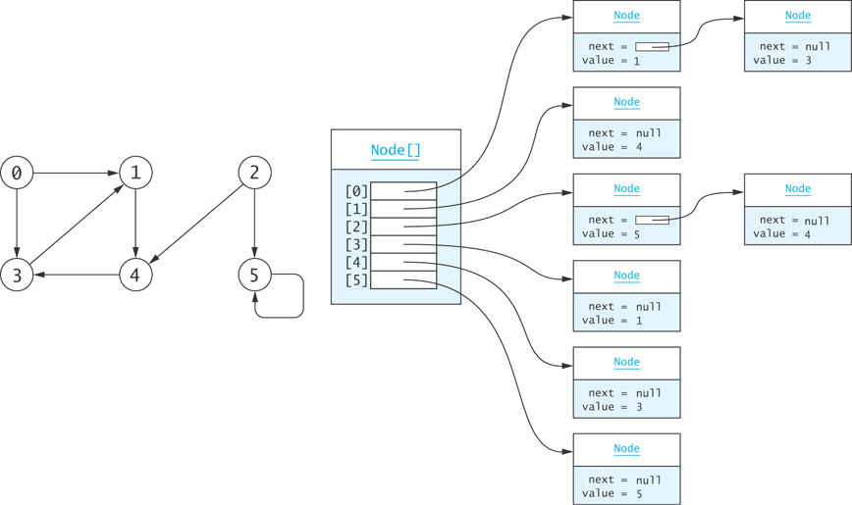
Adjacency List – Directed Graph Example
Notes:
Implementation will actually have an Edge object in each vertex (node), instead of just the value
Search engines like Google model the Internet as a graph:
Web pages are the vertices
Links among Web pages are the edges
This is a directed graph – a link from one page to another does not necessarily imply a link in the reverse order
e.g. of an edge from vertex to itself – a link from a page to itself e.g. bottom of web page has “back to top” link

Slide 48
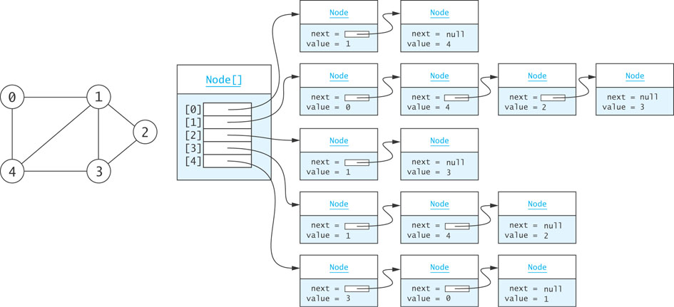
Adjacency List – Undirected Graph Example

Slide 49
Adjacency Matrix
Use a two-dimensional array to represent the graph
For an unweighted graph, the entries can be boolean or int values:
true or 1, edge exists
false or 0, no edge
Integer values have benefits over boolean values for some graph algorithms that use matrix multiplication

Slide 50
Adjacency Matrix (cont.)
For a weighted graph, the matrix would contain the weights
Since 0 is a valid weight, the Java value Double.POSITIVE_INFINITY can represent the absence of an edge
An unweighted graph would contain the value 1.0 for the presence of an edge
In an undirected graph, the matrix is symmetric, so only the lower triangle of the matrix needs to be saved (an example is on next slide)

Slide 51
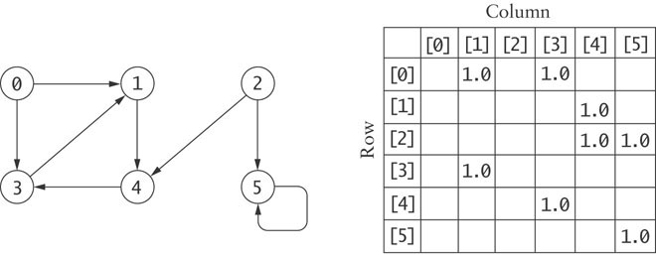
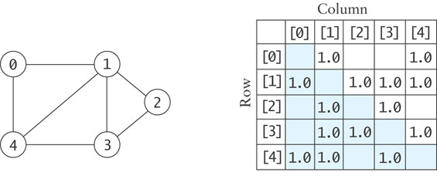
Adjacency Matrix (cont.)

Slide 52
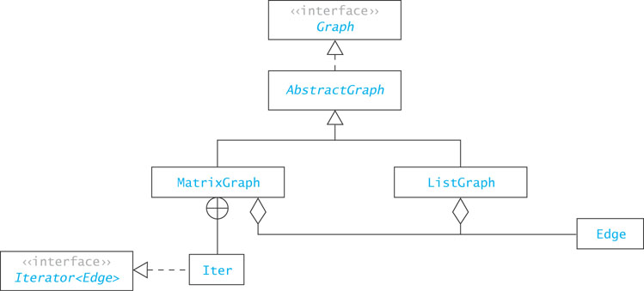
Overview of the Graph Class Hierarchy
Notes:
See https://www.uml-diagrams.org/class-reference.html for explanation of anchor icon (cross inside a circle) – used for Nested Classifiers

Slide 53
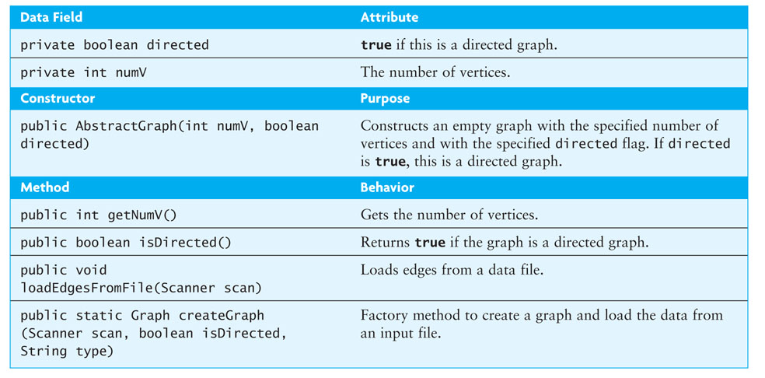
Class AbstractGraph

Slide 54
MatrixGraph Class
The MatrixGraph class extends the AbstractGraph class by providing a two-dimensional array for storing edge weights
double[][] edges;
Upon creation of a MatrixGraph class, the constructor sets the number of rows (vertices)

Slide 55
Storage Efficiency:
For adjacency matrix:
if graph is undirected, matrix is symmetric so only need store one half of matrix
For adjacency matrix, if graph is sparse, there will be lots of wasted space
On the other hand, for adjacency lists:
each edge is represented by Edge object e.g. (2,3, 5)
Also each vertex (node) has reference to next vertex (node)
Adjacency matrix only stores weight for each edge
i.e. a lot more storage for edge in adjacency lists
55

Slide 56
For storage efficiency:
If a graph is sparse, use adjacency lists
If a graph is not sparse, use adjacency matrix
56
Notes:
Pros and cons:
Adjacency matrix
Allows us to determine whether there is an edge from vertex i to vertex j in O(1) time
Adjacency list
Allows us to find all vertices adjacent to a given vertex j efficiently
If the graph is sparse, adjacency list requires less space

Slide 57
Traversals of Graphs
Section 10.4

Slide 58
Traversals of Graphs
Most graph algorithms involve visiting each vertex in a systematic order
As with trees, there are different ways to do this
The two most common traversal algorithms are the breadth-first search and the depth-first search

Slide 59
Breadth-First Search
In a breadth-first search,
visit the start vertex first,
then all vertices that are adjacent to it,
then all vertices that can be reached by a path from the start vertex containing two edges,
then all vertices that can be reached by a path from the start vertex containing three edges,
and so on
We must visit all vertices for which the shortest path from the start vertex is length k before we visit any vertex for which the shortest path from the start vertex is length k+1
There is no special start vertex– we arbitrarily choose the vertex with label 0

Slide 60
Use the following algorithm, requiring a queue:
bfs(start_vertex)
mark all vertices as not_visited create an empty queue queue.enqueue(start_vertex) //add to queue while not queue.empty do vertex := queue.dequeue() // remove from queue visit(vertex) mark vertex as visited
for all vertices v adjacent to vertex such that v is not_visited queue.enqueue(v) //add to queue
mark vertex v as waiting
In this algorithm, each vertex is marked as one of not_visited, visited or waiting. Initially all vertices are marked as not_visited.
Note: breadth-first search of an unweighted graph finds the shortest path from the start vertex to all other vertices

Slide 61
To trace this algorithm, use a table with the following headings:
Vertex being visited Queue contents after all adjacent vertices have been enqueued

Slide 62
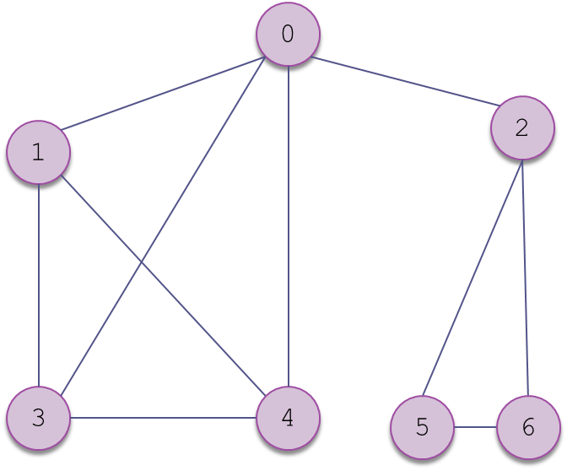
E.g. perform breadth-first traversal of the following graph, starting at vertex 0:

Slide 63
Vertex being visited Queue contents after all adjacent vertices have been enqueued
0
0 1,2,3,4
1 2,3,4
2 3,4,5,6
Etc..

Slide 64
Depth-First Search
In a depth-first search,
start at a vertex,
visit it,
choose one adjacent vertex to visit;
then, choose a vertex adjacent to that vertex to visit,
and so on until you go no further;
then back up and see whether a new vertex can be found

Slide 65
Depth-First Search
A recursive version of the algorithm:
dfs(v) // v is start vertex
mark v as visited
preorder-process v
for all vertices i adjacent to v such that i not visited
dfs(i)
postorder-process v
Note: dfs is equivalent to preorder and postorder tree traversal

Slide 66
E.g. perform depth-first traversal of the following graph, starting at vertex 0:

Slide 67
dfs(0)
mark 0 as visited
preorder-process(0)
dfs(1)
mark 1 as visited
preorder-process(1)
dfs(3)
mark 3 as visited
preorder-process(3)
dfs(4)
mark 4 as visited
preorder-process(4)
//no further recursive calls here
postorder-process(4)
etc.....

Slide 68
Application of Graph Traversals
Section 10.5

Slide 69
Problem
Design a program that will find the shortest path through a maze
Use breadth-first traversal here

Slide 70
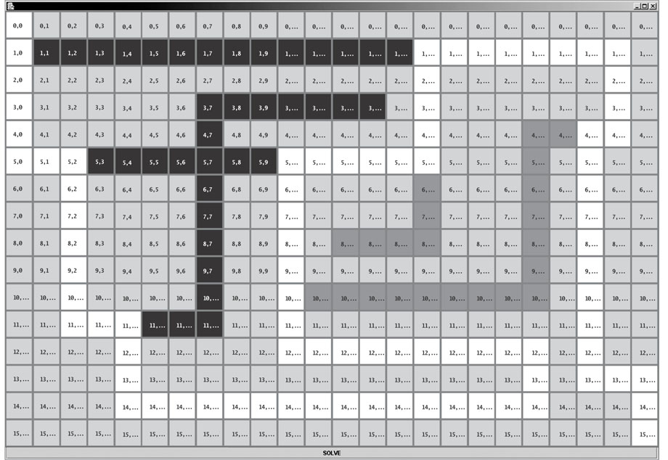
Problem (cont.)
Notes:
A recursive backtracking algorithm was used to find a path from top-left to bottom-right. The path found was not an optimal solution. This is because south was attempted before east.
Gray cells are barriers. White cells show a solution. Black squares show cells that were visited but rejected.
Dark grey cells were not visited.

Slide 71
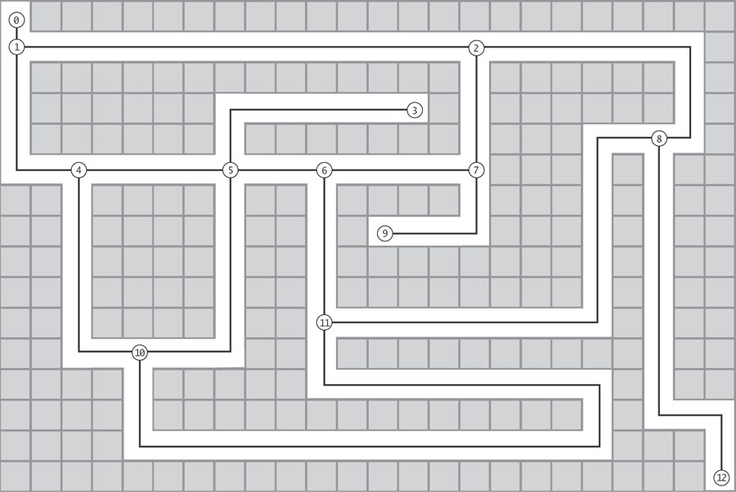
Analysis
We can represent the maze on the previous slide as a graph, with a vertex at each decision point

Slide 72
Analysis (cont.)
With the maze represented as a graph, we need to find the shortest path from the start point (0) to the end point (12)
Notes:
This path will contain the smallest number of vertices not necessarily the smallest number of cells

Slide 73
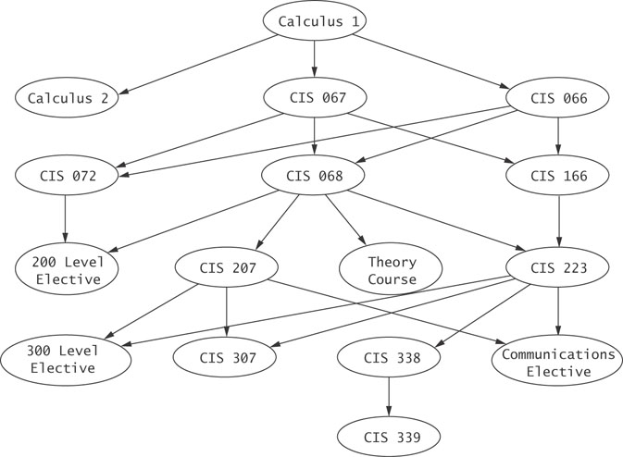
Topological Sort of a Graph
This graph shows prerequisites of courses e.g. Calculus 1 is a prerequisite of Calculus 2
This is an example of a directed acyclic graph (DAG) i.e. it is a directed graph which contains no cycles.
Once you pass through a vertex, there is no path back to the vertex

Slide 74
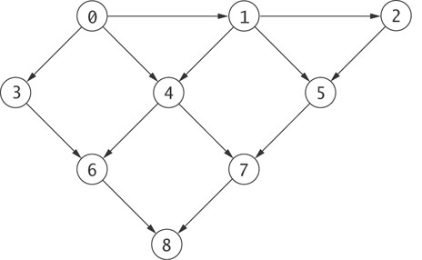
Another Directed Acyclic Graph (DAG)

Slide 75
Topological Sort of a Graph (cont.)
A topological sort of the vertices of a DAG is an ordering of the vertices such that if (u, v) is an edge, the u appears before v
This must be true for all edges
There may be many valid paths through a DAG and many valid topological sorts of a DAG
0, 1, 2, 3, 4, 5, 6, 7, 8 is a valid topological sort of the DAG on the previous slide, but 0, 1, 5, 3, 4, 2, 6, 7, 8 is not

Slide 76
Topological sort of a graph
a topological sort gives an order in which to perform the tasks in a directed acyclic graph where the tasks are the vertices.
This has applications in computer science such as ordering of formula cell evaluation in spreadsheets, dependencies in makefiles, and symbol dependencies in linkers.
E.g. a sequence in which to take modules on a course given the graph of prerequisites

Slide 77
Design
Algorithm for Topological Sort
Perform a depth-first search of the graph
List the vertices in reverse of their postorder traversal
i.e. the list of the vertices in the opposite order of their last visit

Slide 78
Algorithms Using Weighted Graphs
Section 10.6

Slide 79
Finding the Shortest Path from a Vertex to All Other Vertices
The breadth-first search found the shortest path from the start vertex to all other vertices, assuming that the length or weight of each edge was the same or in an unweighted graph
Dijkstra's algorithm finds the shortest path in a weighted directed graph

Slide 80
Applications of Shortest-Path Algorithm
Plenty of applications for shortest path algorithm
Traveling on a starving student budget: What is the cheapest multi-stop airline schedule from Seattle to city X?
Optimizing routing of packets on the internet: ?
Vertices = routers, edges = network links with different delays ? What is the routing path with smallest total delay?
Hassle-free commuting: Finding what highways and roads to take to minimize total delay due to traffic ?
Finding the fastest way to get to coffee vendors on campus from your classrooms

